Slide 1
深入浅出讲解 DeepSeek + K8S 分布式推理
Hongbing Kay Yan
2025.07

Slide 2
目录
Kubernetes 分布式推理
WG-Serving 工作组核心贡献
LWS(Leader Worker Set) 深度解析
技术演进和未来展望
Content

Slide 3
Kubernetes 分布式推理
Part
01

Slide 4
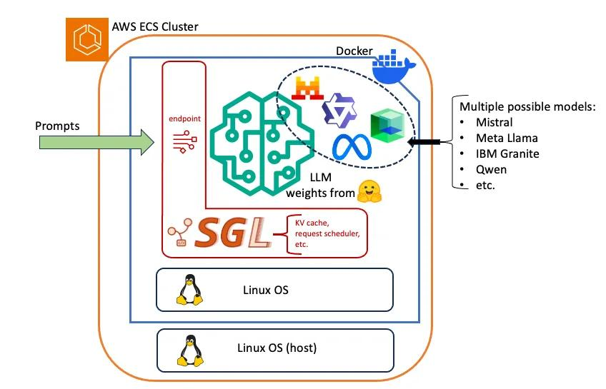
Inference: 从一个单机的 Hello World 开始
docker run --gpus all \
--shm-size 32g \
-p 30000:30000 \
-v ~/.cache/huggingface:/root/.cache/huggingface \
--env "HF_TOKEN=<secret>" \
--ipc=host \
lmsysorg/sglang:latest \
python3 -m sglang.launch_server --model-path meta-llama/Llama-3.1-8B-Instruct --host 0.0.0.0 --port 30000
启动一个 SGLang 的 Docker 容器
从 huggingface 下载 Llama 模型
在 GPU 上跑起来

Slide 5

DeepSeek R1 671b Hardware requirements
Weight Type | Configuration
Full precision FP8 (recommended) | 8 x H200
 | 8 x MI300X
 | 2 x 8 x H100/800/20
Full precision BF16 | 2 x 8 x H200
 | 2 x 8 x MI300X
 | 4 x 8 x H100/800/20
 | 4 x 8 x A100/A800
Quantized weights (AWQ) | 8 x H100/800/20
 | 8 x A100/A800
Quantized weights (int8) | 16 x A100/800
 | 32 x L40S
模型太大，一锅“炖”不下
DeepSeek R1 需要 1.3TB (FP16), 671GB (FP8) 显存，
因此 DeepSeek R1 需要分布式推理

Slide 6




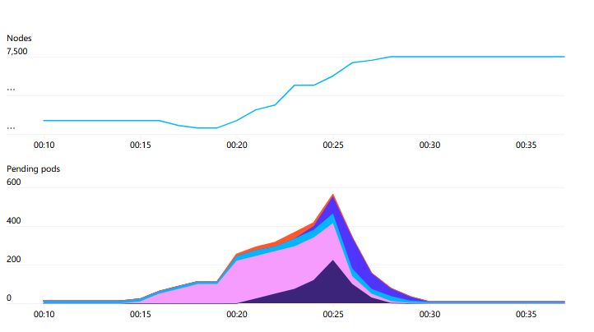
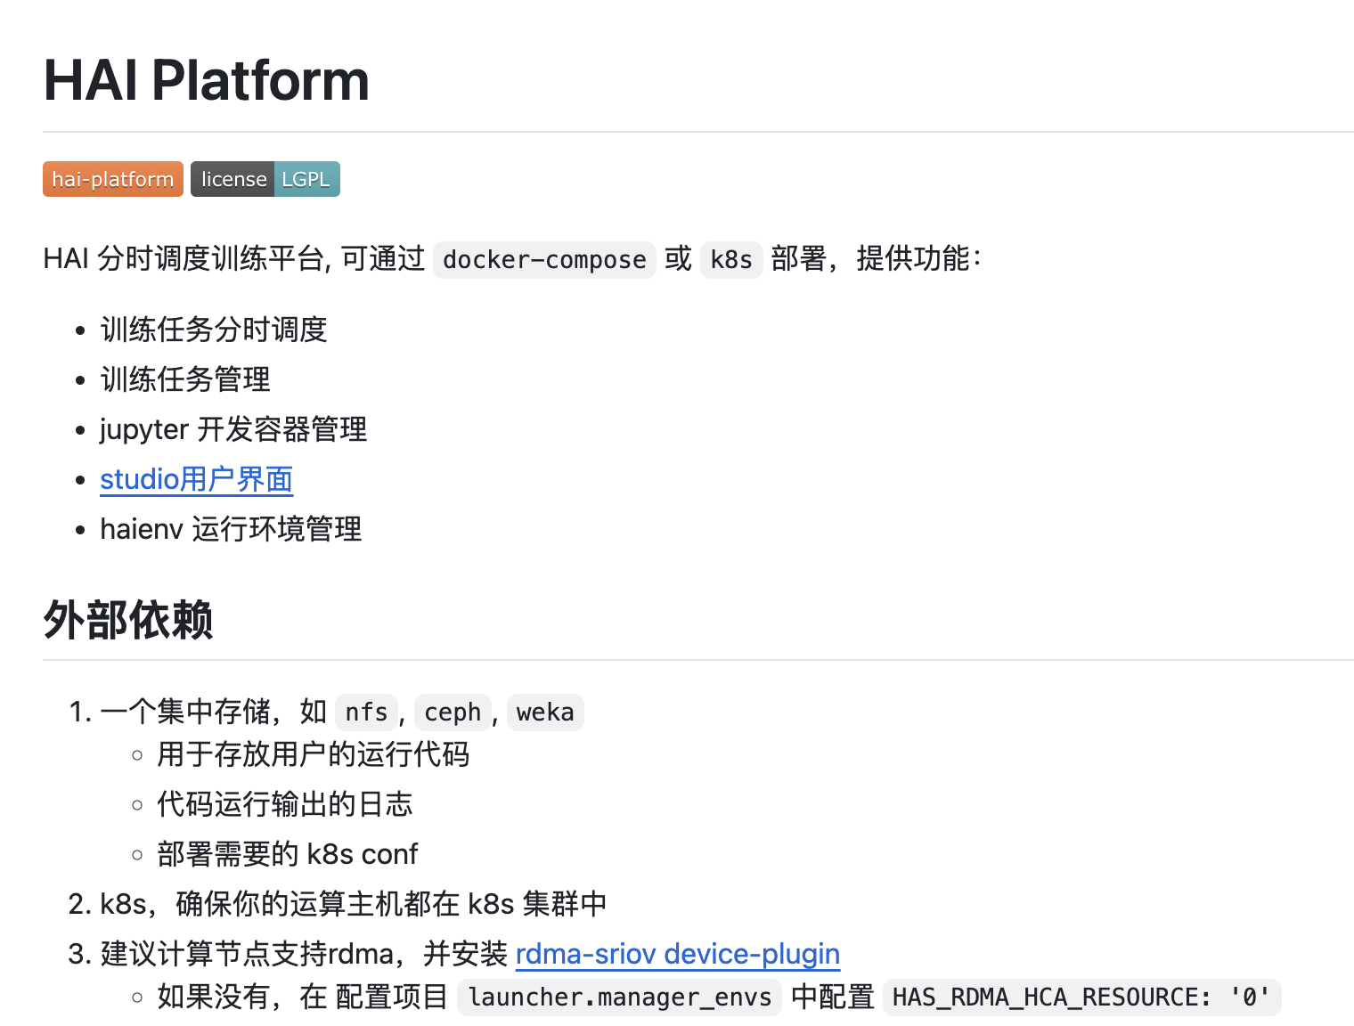
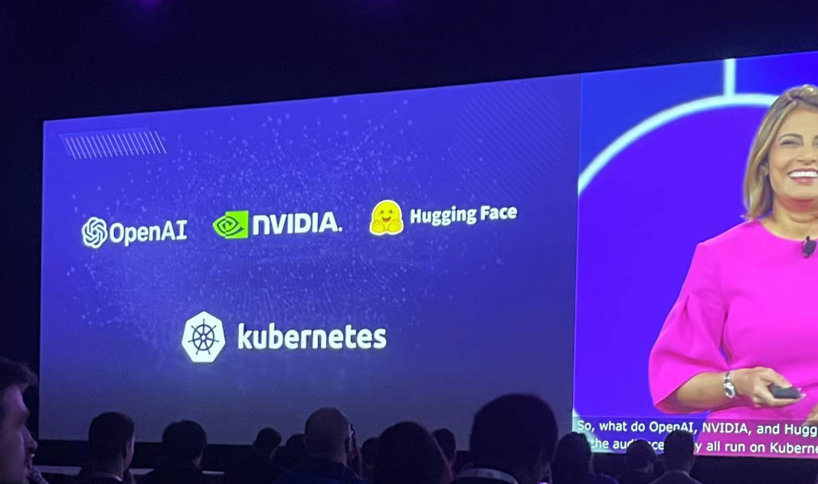
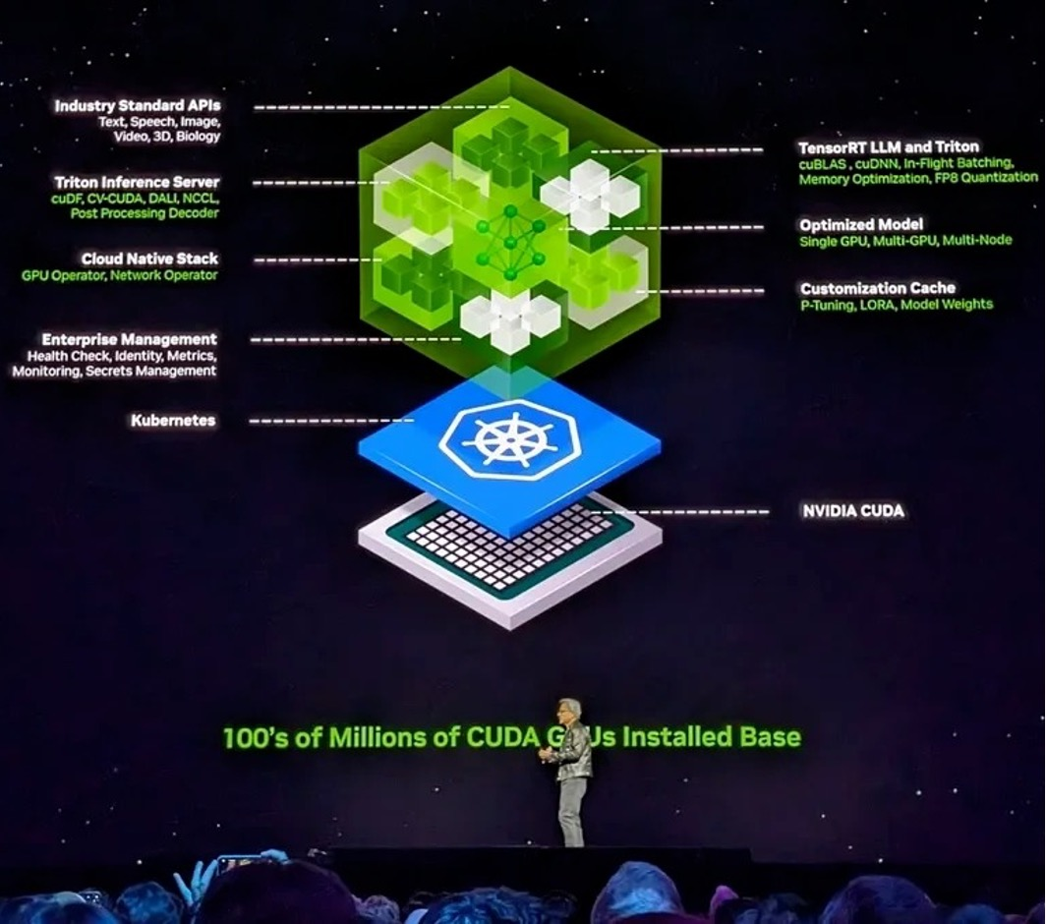
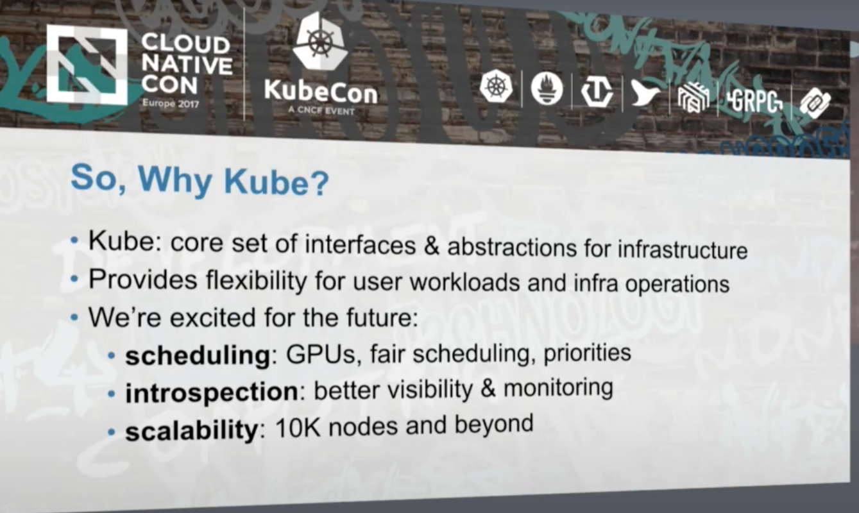

Kubernetes 是高效管理 AI 基础设施的行业标准
OpenAI 博客《Scaling Kubernetes to 7,500 nodes》
采用 Kubernetes 集群扩展到 7,500 个节点，为大模型提供了可扩展的基础设施
CNCF 主席 Priyanka Sharma 2023 演讲:
OpenAI、Nvidia 、Hugging Face
全都运行在 Kubernetes 之上
幻方 AI 博客《HAI Platform：开源的 AI 训练平台》
幻方 AI 高效管理 GPU 集群资源的 AI 训练平台方案 - HAI Platform 运行在 Kubernetes 之上
Nvidia CEO 黄仁勋 Computex 2024 演讲:
人工智能新范式
需建立在 Kubernetes 基础之上
OpenAI 工程师演讲：
自从 2017 年，OpenAI 的基础设施皆建立在 Kubernetes 之下，目前集群规模早已超过万节点

Slide 7
​​分布式推理的 核心挑战与需求​​
大规模模型（如 DeepSeek R1 671B LLaMA 405B）的推理部署
异构资源（GPU/TPU/国产GPU）的高效利用
推理引擎 TP/PP/EP 并行 和 PD 分离 需要
弹性伸缩与故障恢复机制

Slide 8
K8S WG-Serving 工作组核心贡献
Part
02

Slide 9
What is K8S WG Serving?
Discuss and enhance serving workloads on Kubernetes, specifically focusing on hardware-accelerated AI/ML inference.
增强 Kubernetes Workload Controllers 优化 Kubernetes Workload Controllers，实现与 GPU 的无缝集成，并通过主流推理服务框架和模型服务器提升其性能。
探索 Orchestration 和 Scalability 解决方案 调研并参与能改进 推理工作负载 orchestration, scaling, and load balancing 的新项目，确保与基于Kubernetes的其他工作负载兼容。
优化推理工作负载的资源共享 在Kubernetes上安全运行服务型工作负载的同时，动态将闲置资源分配给批处理框架，实现资源利用率最大化。（推理和训练共享集群）

Slide 10
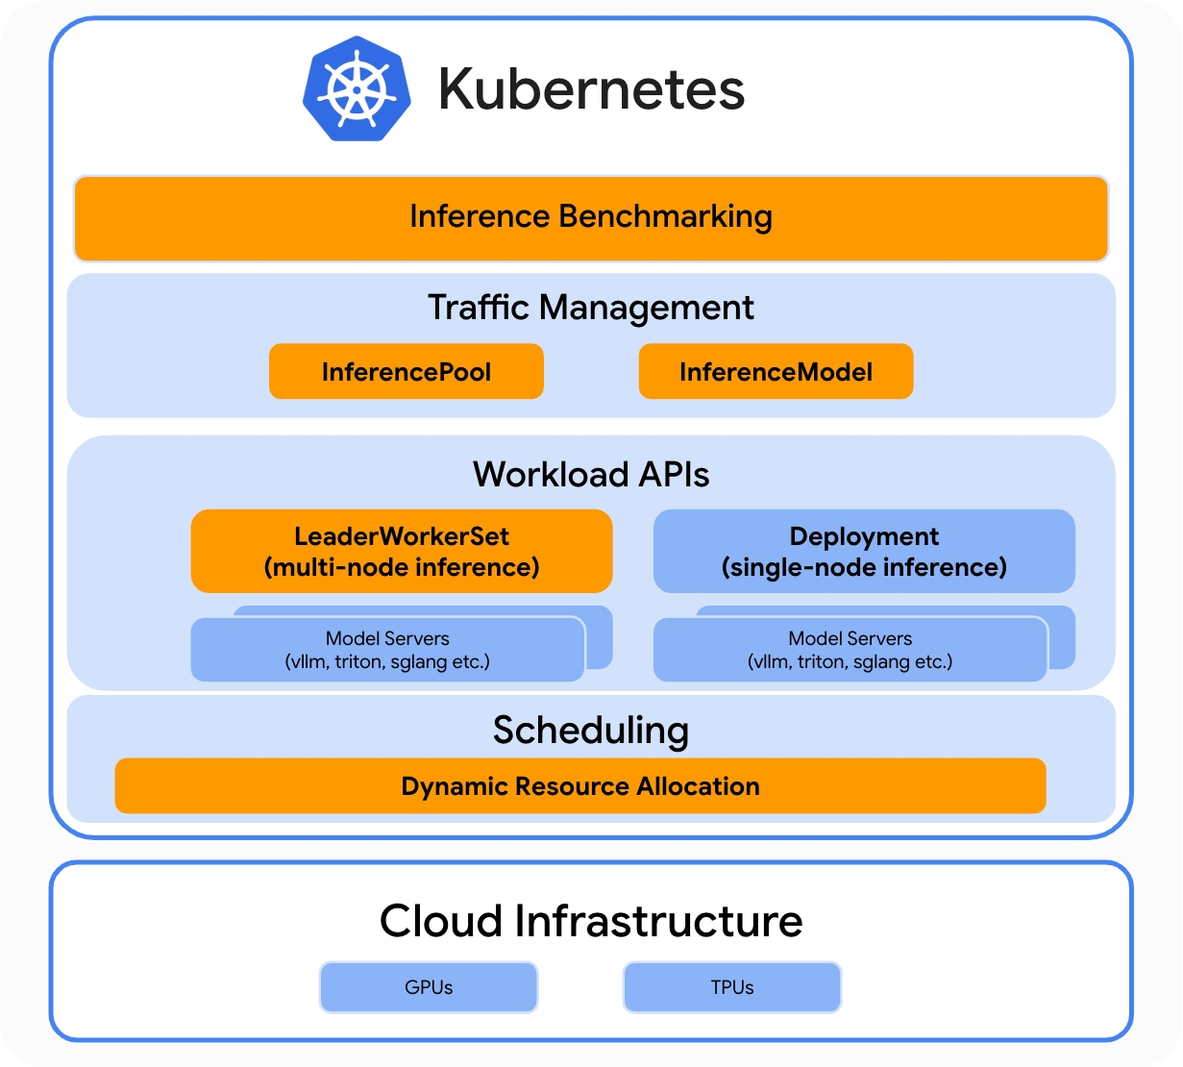
Gen-AI inference aware Kubernetes
Inference performance
GenAI inference performance benchmarking tool
Gateway API Inference Extension
LLM-aware routing, rather than traditional round robin.
LeaderWorkerSet (LWS)
Enables multi-host inference for state-of-the-art models
Dynamic Resource Allocation (DRA)
simplifies and automates how Kubernetes allocates and schedules GPUs, TPUs, and other devices to pods and workloads.
https://cloud.google.com/blog/products/containers-kubernetes/google-bytedance-and-red-hat-improve-ai-on-kubernetes

Slide 11
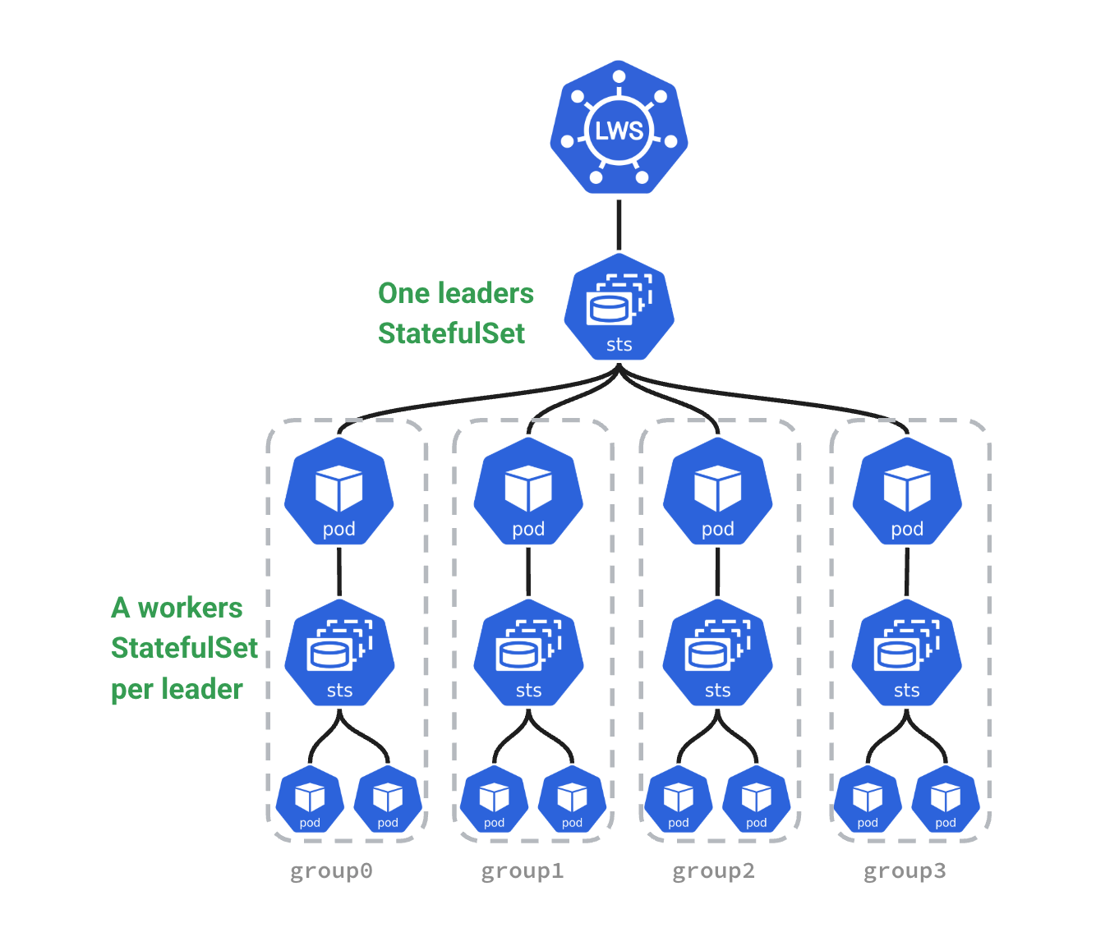
LeaderWorkerSet (LWS)
An API for deploying a group of pods as a unit of
replication
A group is a “Super Pod”: a single leader and multiple workers
Built on top of StatefulSet and supports most of it semantics

Slide 12
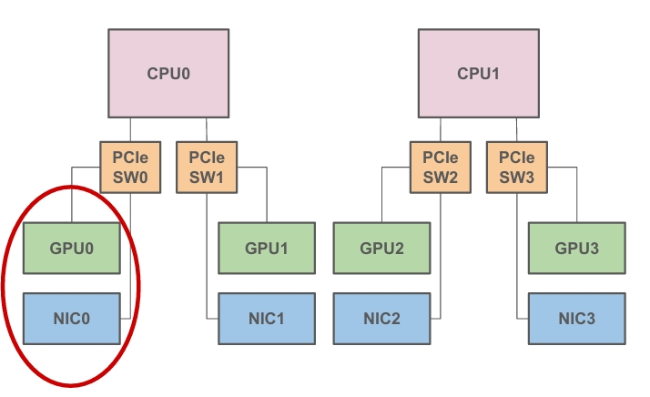
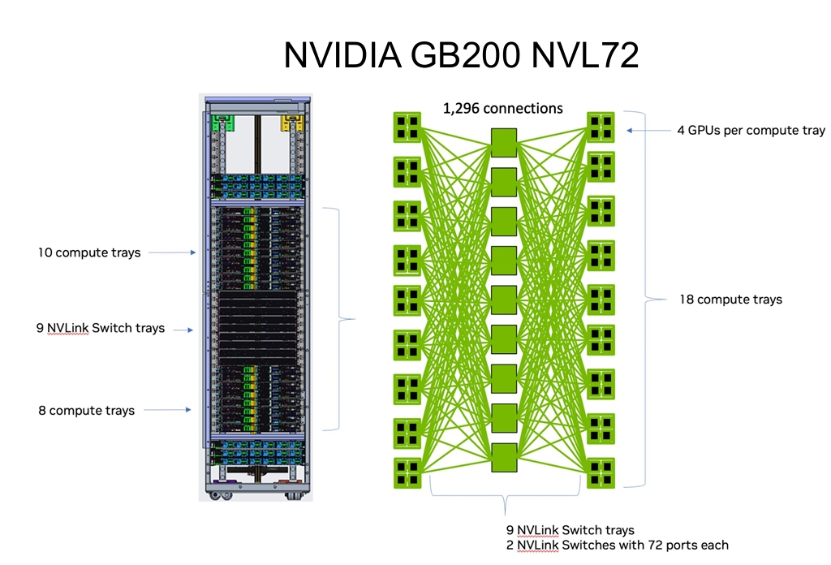
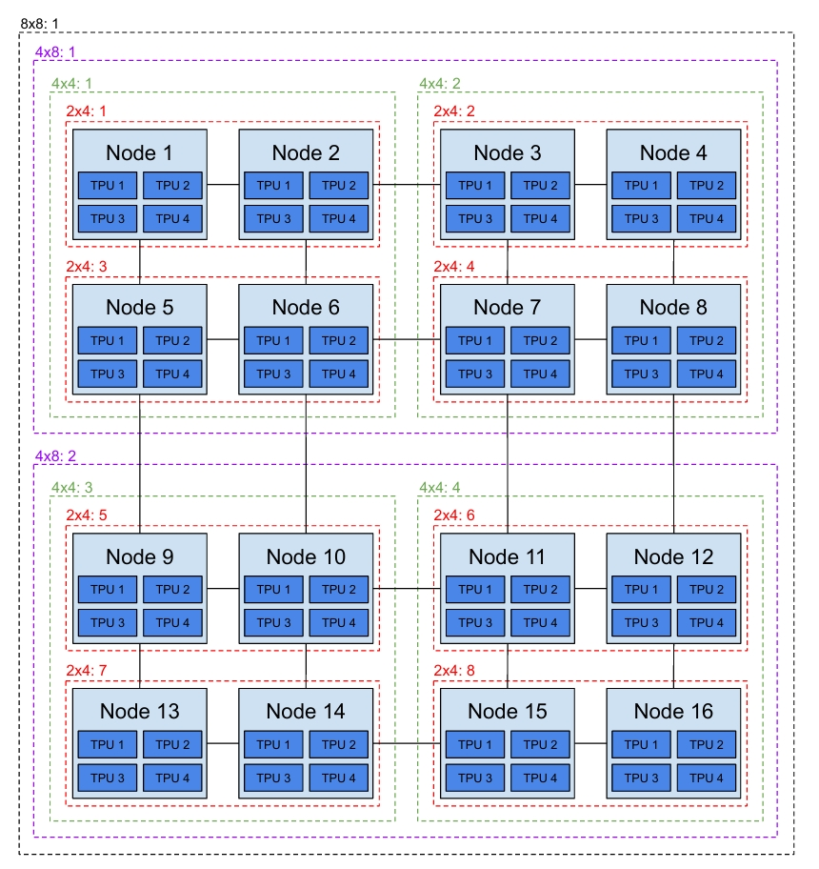
Dynamic Resource Allocation (DRA) - Challenge
AI/ML workloads can require a large number of accelerators. As the number of accelerators and nodes grow, so does the complexity of scheduling and the chance that we might encounter failures.
More Nodes ⇒ More Complex
Node Topology - GPU / NIC
Google TPU

Slide 13
Dynamic Resource Allocation (DRA) - Solution
Device Plugin
DRA
apiVersion: resource.k8s.io/v1alpha2
kind: ResourceClaim
metadata:
name: big-gpu-with-aligned-nic
spec:
devices:
requests:
- name: gpu
deviceClassName: gpu.nvidia.com
selectors:
- cel:
expression: "device.capacity['memory'].compareTo(quantity('80Gi')) >= 0"
- name: nic
deviceClassName: rdma.nvidia.com
selectors:
- cel:
expression: "device.attribute['sriovType'] == 'vf'"
constraints:
- requestNames: ["gpu", "nic"]
matchAttribute: k8s.io/pcieRoot
resources:
limits:
nvidia.com/gpu: 1
rdma/rdma_a: 1
灵活性不足，
如无法配置“GPU/NIC”拓扑感知
灵活的配置，适应复杂情况

Slide 14
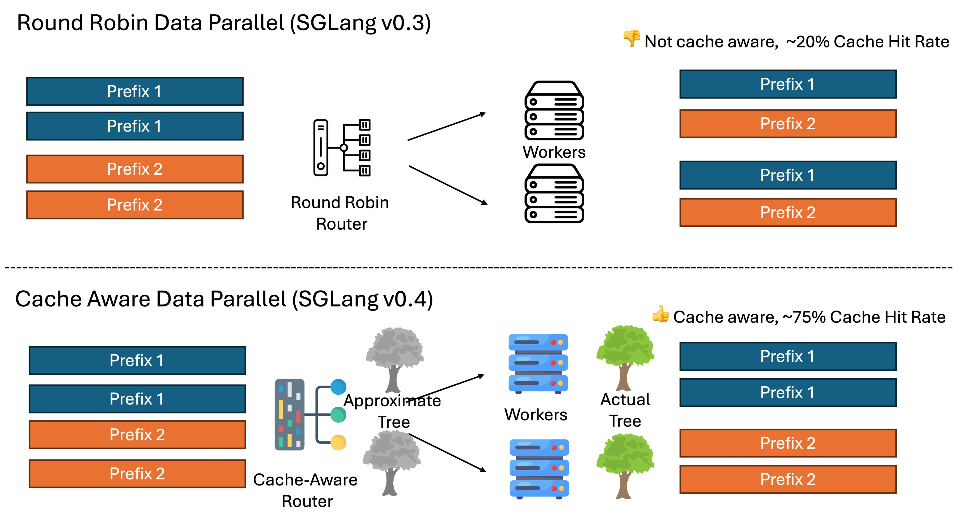
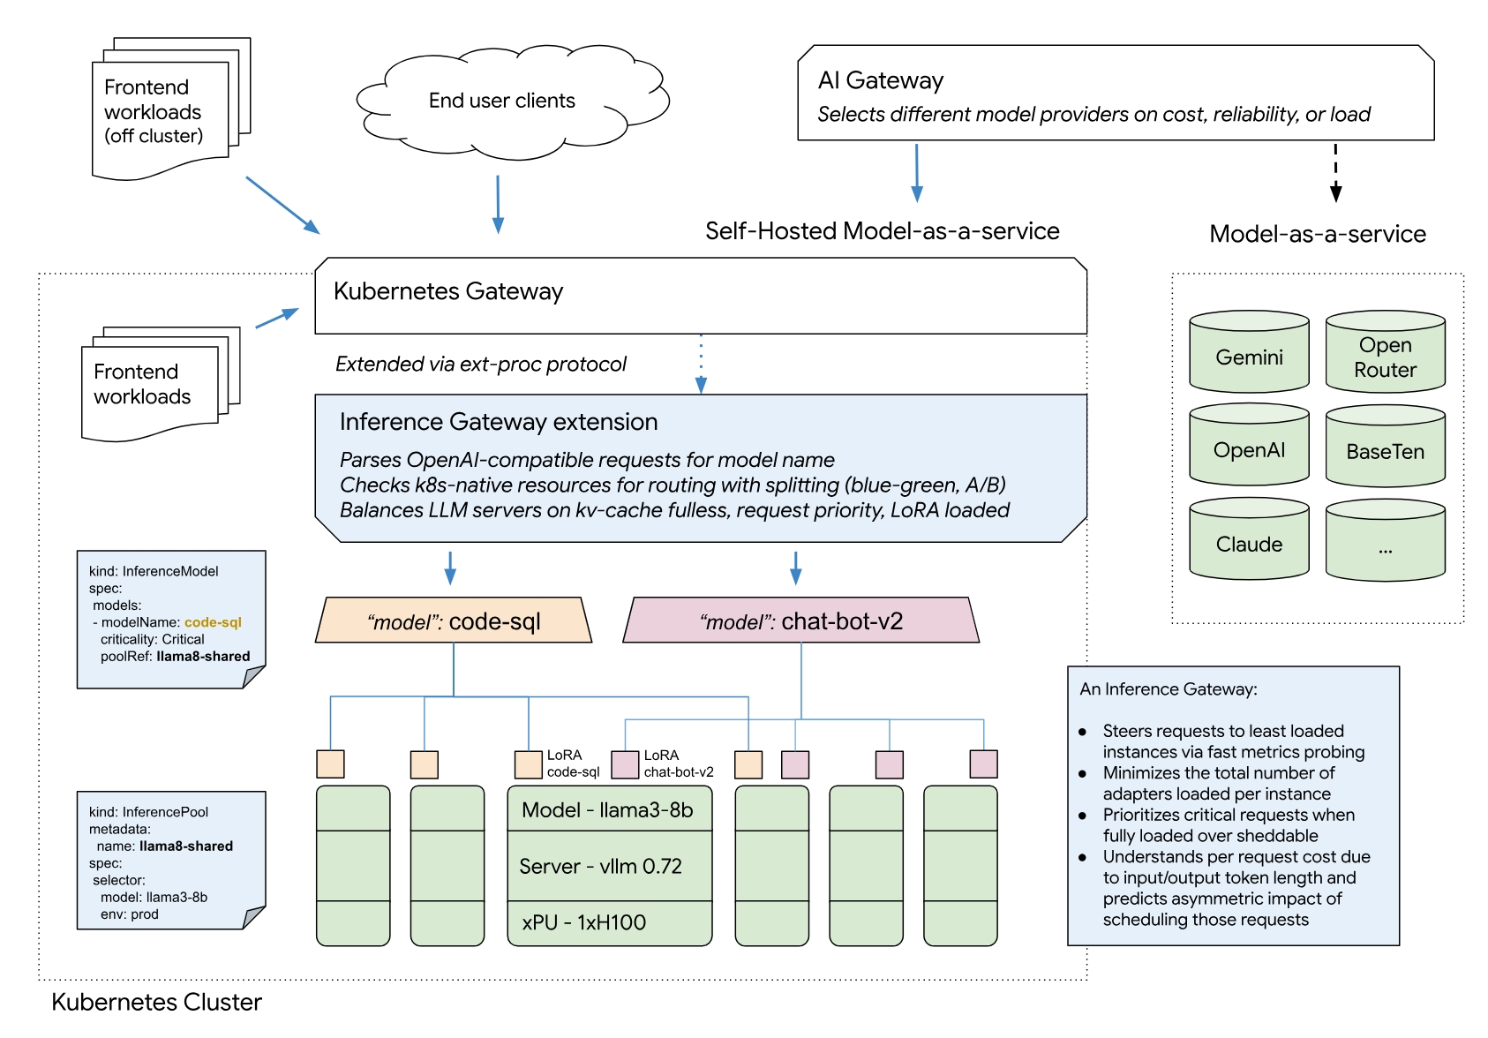
Gateway API Inference Extension
Formerly known as: llm-instance-gateway
This Envoy extension upgrades an ext-proc-capable proxy or gateway
“Round Robin” is not good for LLM inference, So:
Improves the tail latency and throughput of LLM completion requests
kv-cache and request cost aware
avoiding evictions or queueing as load increases
Provides Kubernetes-native declarative APIs
end to end observability
Ensures operational guardrails between different client model names

Slide 15
Others Works
kind: Pod
spec:
containers:
- …
volumeMounts:
- name: deepseek -volume
mountPath: /path/to/directory
volumes:
- name: deepseek -volume
image:
reference: deepseek:r1
OCI Volume Source
AutoScale
InferencePerf
Service Catelog
OCI VolumeSource

Slide 16
LeaderWorkerSet (LWS) 深度解析
Part
03

Slide 17
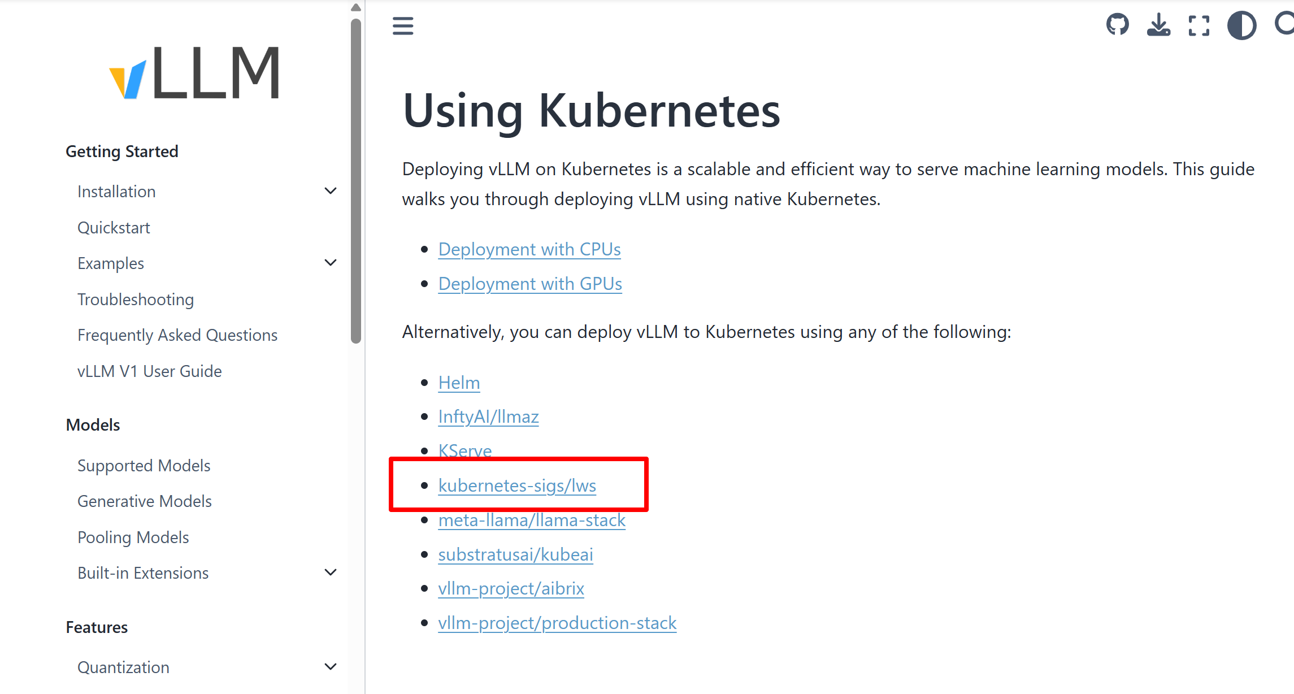
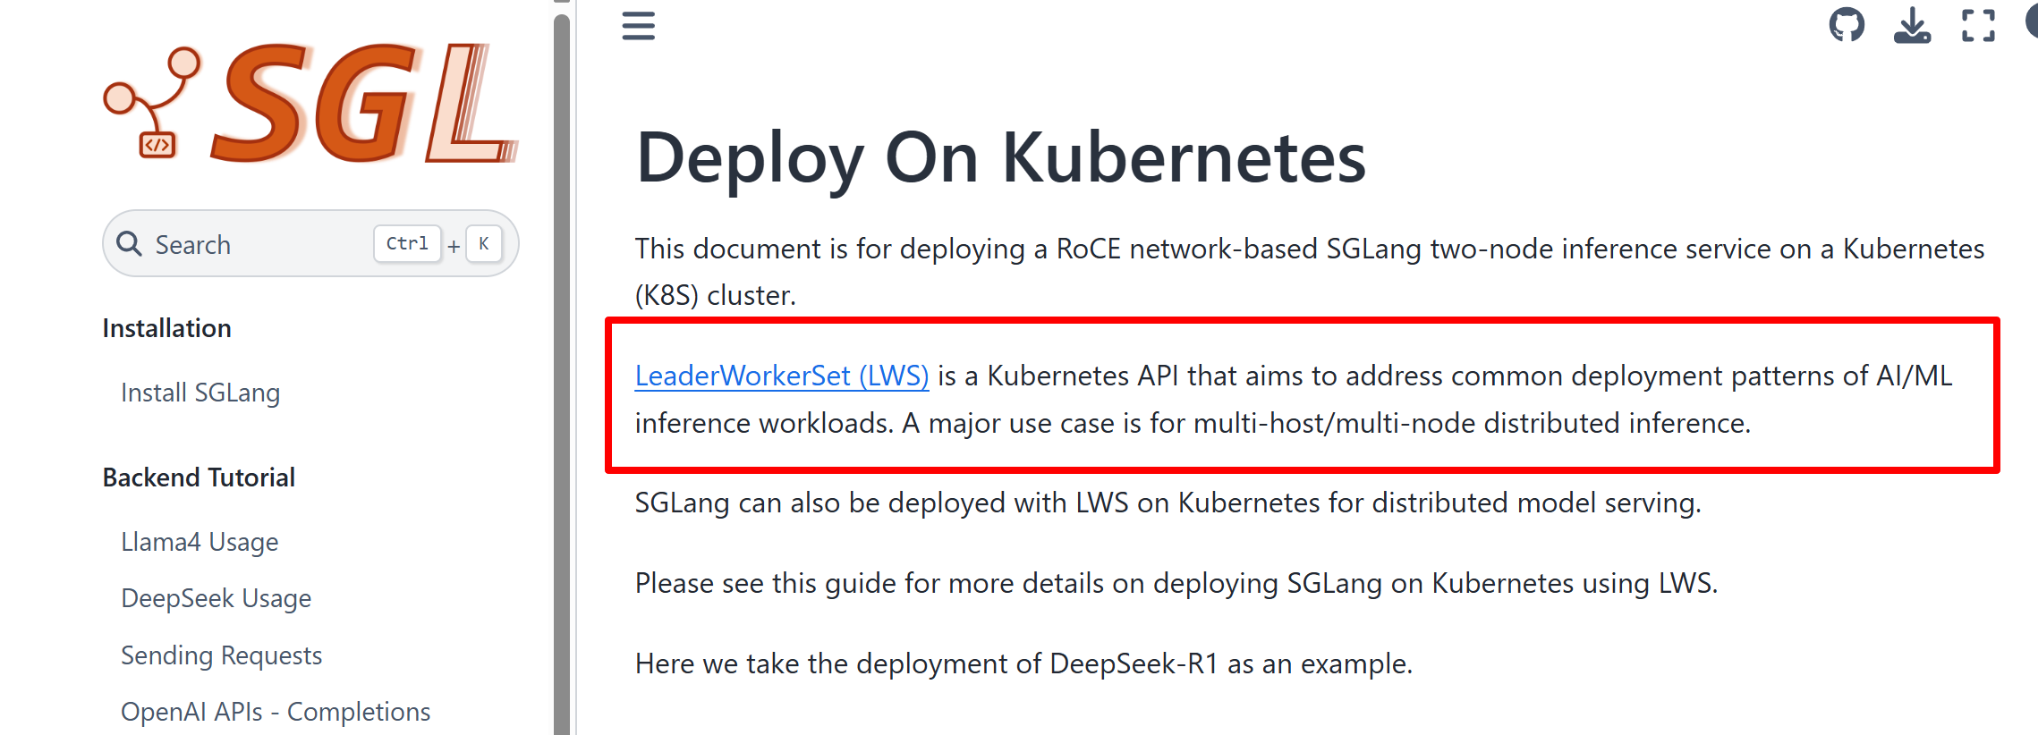
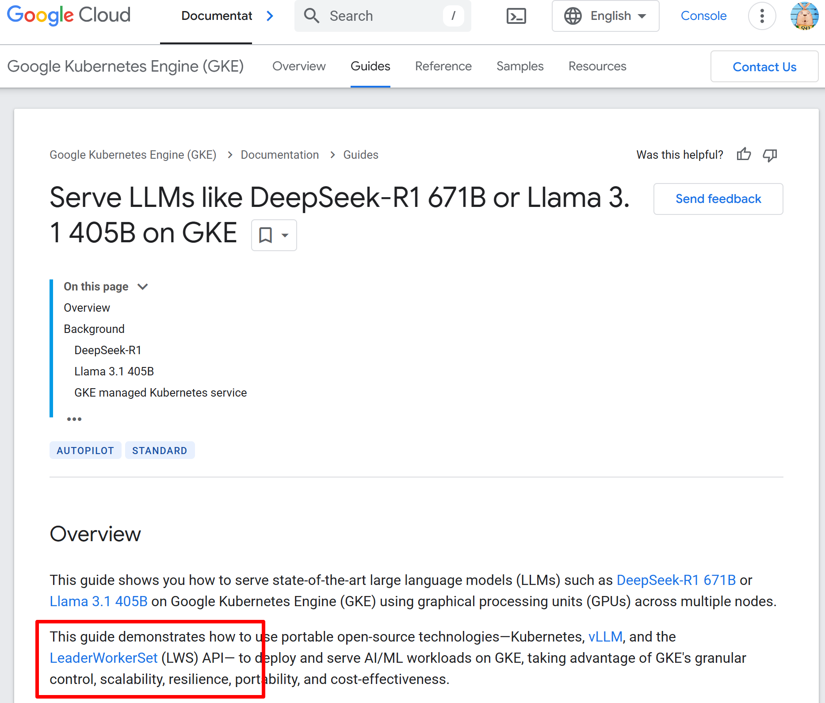
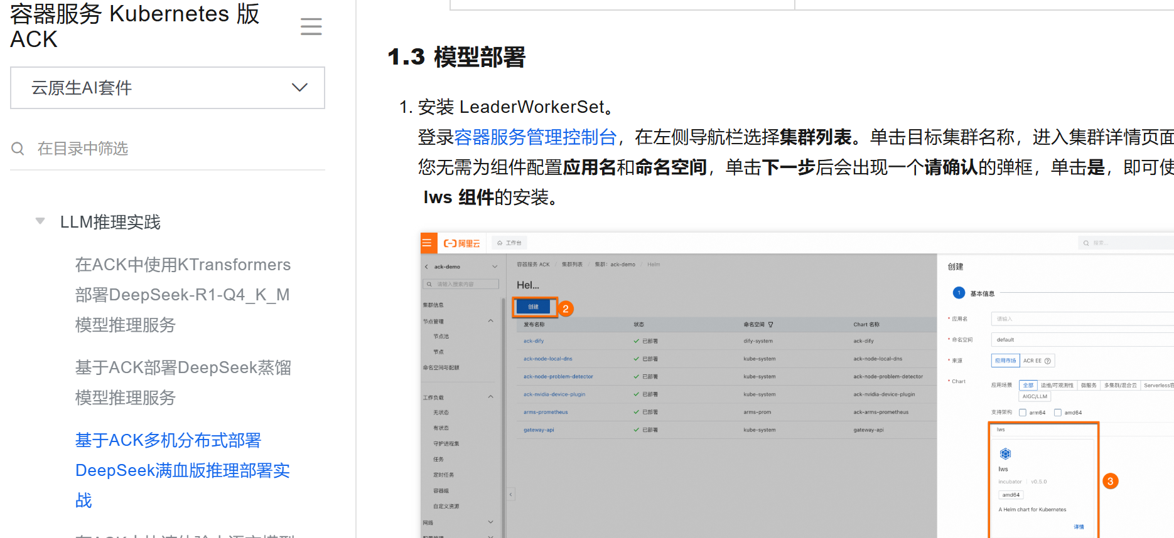
LWS - 分布式 DeepSeek 推理 最广泛 的 实践
Influence Engine
vLLM
Sglang
Cloud
GKE
AWS
阿里云
腾讯云
火山云
…
Hardware
Nvidia

Slide 18
使用 LWS 创建一个 分布式 DeepSeek 推理
apiVersion: leaderworkerset.x-k8s.io/v1
kind: LeaderWorkerSet
metadata:
name: vllm
spec:
replicas: 2
leaderWorkerTemplate:
size: 2
leaderTemplate:
spec:
containers:
- name: vllm-leader
image: vllm/vllm-openai:latest
command:
- sh
- -c
- "bash /vllm-workspace/examples/online_serving/multi-node-serving.sh leader --ray_cluster_size=$(LWS_GROUP_SIZE);
python3 -m vllm.entrypoints.openai.api_server --port 8080 --model meta-llama/ deepseek-ai/DeepSeek-R1 --tensor-parallel-size 8 --pipeline_parallel_size 2"
resources:
limits:
nvidia.com/gpu: "8"
workerTemplate:
spec:
containers:
- name: vllm-worker
image: vllm/vllm-openai:latest
command:
- sh
- -c
- "bash /vllm-workspace/examples/online_serving/multi-node-serving.sh worker --ray_address=$(LWS_LEADER_ADDRESS)"
resources:
limits:
nvidia.com/gpu: "8"
- name: HUGGING_FACE_HUB_TOKEN

Slide 19
LeaderWorkerSet Features
Group of Pods as a unit: Supports a tightly managed group of pods that represent a “super pod”
Unique pod identity: Each pod in the group has a unique index from 0 to n-1.
Parallel creation: Pods in the group will have the same lifecycle and be created in parallel.
Dual-template, one for leader and one for the workers: A replica is a group of a single leader and a set of workers, and allow to specify a template for the workers and optionally use a second one for the leader pod.
Multiple groups with identical specifications: Supports creating multiple “replicas” of the above mentioned group. Each group is a single unit for rolling update, scaling, and maps to a single exclusive topology for placement.
A scale subresource: A scale endpoint is exposed for HPA to dynamically scale the number replicas (aka number of groups)
Rollout and Rolling update: Supports performing rollout and rolling update at the group level, which means the groups are upgraded one by one as a unit (i.e. the pods within a group are updated together).
Topology-aware placement: Opt-in support for pods in the same group to be co-located in the same topology.
All-or-nothing restart for failure handling: Opt-in support for all pods in the group to be recreated if one pod in the group failed or one container in the pods is restarted.

Slide 20
Unique pod identity
apiVersion: leaderworkerset.x-k8s.io/v1
kind: LeaderWorkerSet
metadata:
name: sglang
spec:
replicas: 2
leaderWorkerTemplate:
size: 2
leaderTemplate:
spec:
containers:
- name: sglang-leader
image: lmsysorg/sglang:latest
command:
- python3
- -m
- sglang.launch_server
- --model-path
- meta-llama/Meta-Llama-3.1-8B-Instruct
- --tp
- "2" # Size of Tensor Parallelism
- --dist-init-addr
- $(LWS_LEADER_ADDRESS):20000
- --nnodes
- $(LWS_GROUP_SIZE)
- --node-rank
- $(LWS_WORKER_INDEX)
- --trust-remote-code
- --host
- "0.0.0.0"
- --port
- "40000"
workerTemplate:
spec:
containers:
- name: sglang-worker
image: lmsysorg/sglang:latest
command:
- python3
- -m
- sglang.launch_server
- --model-path
- meta-llama/Meta-Llama-3.1-8B-Instruct
- --tp
- "2" # Size of Tensor Parallelism
- --dist-init-addr
- $(LWS_LEADER_ADDRESS):20000
- --nnodes
- $(LWS_GROUP_SIZE)
- --node-rank
- $(LWS_WORKER_INDEX)
- --trust-remote-code

Slide 21
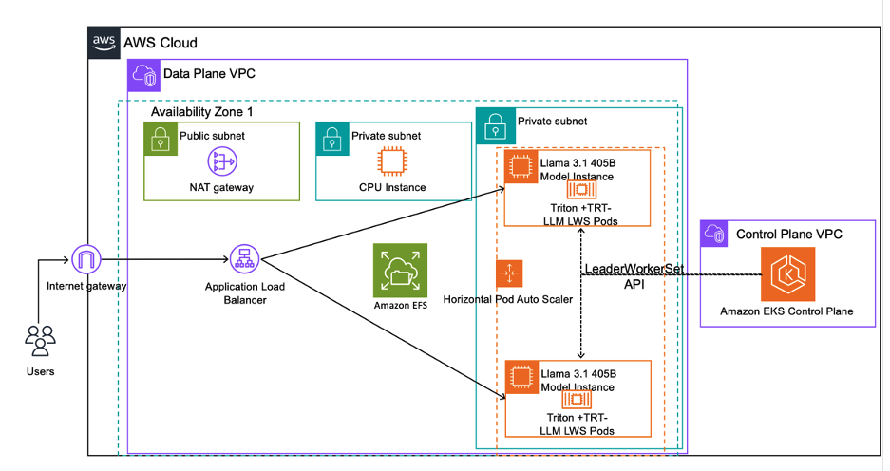
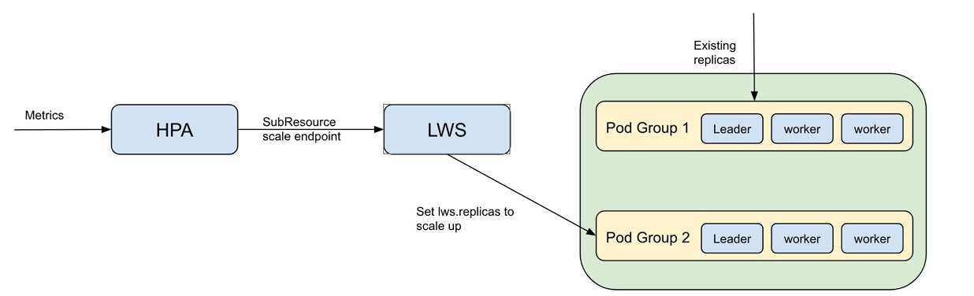
Auto Scale with HPA
可以与 k8s HPA 无缝对接，将 LWS 作为HPA 扩容的Target，实现推理服务整组扩容

Slide 22
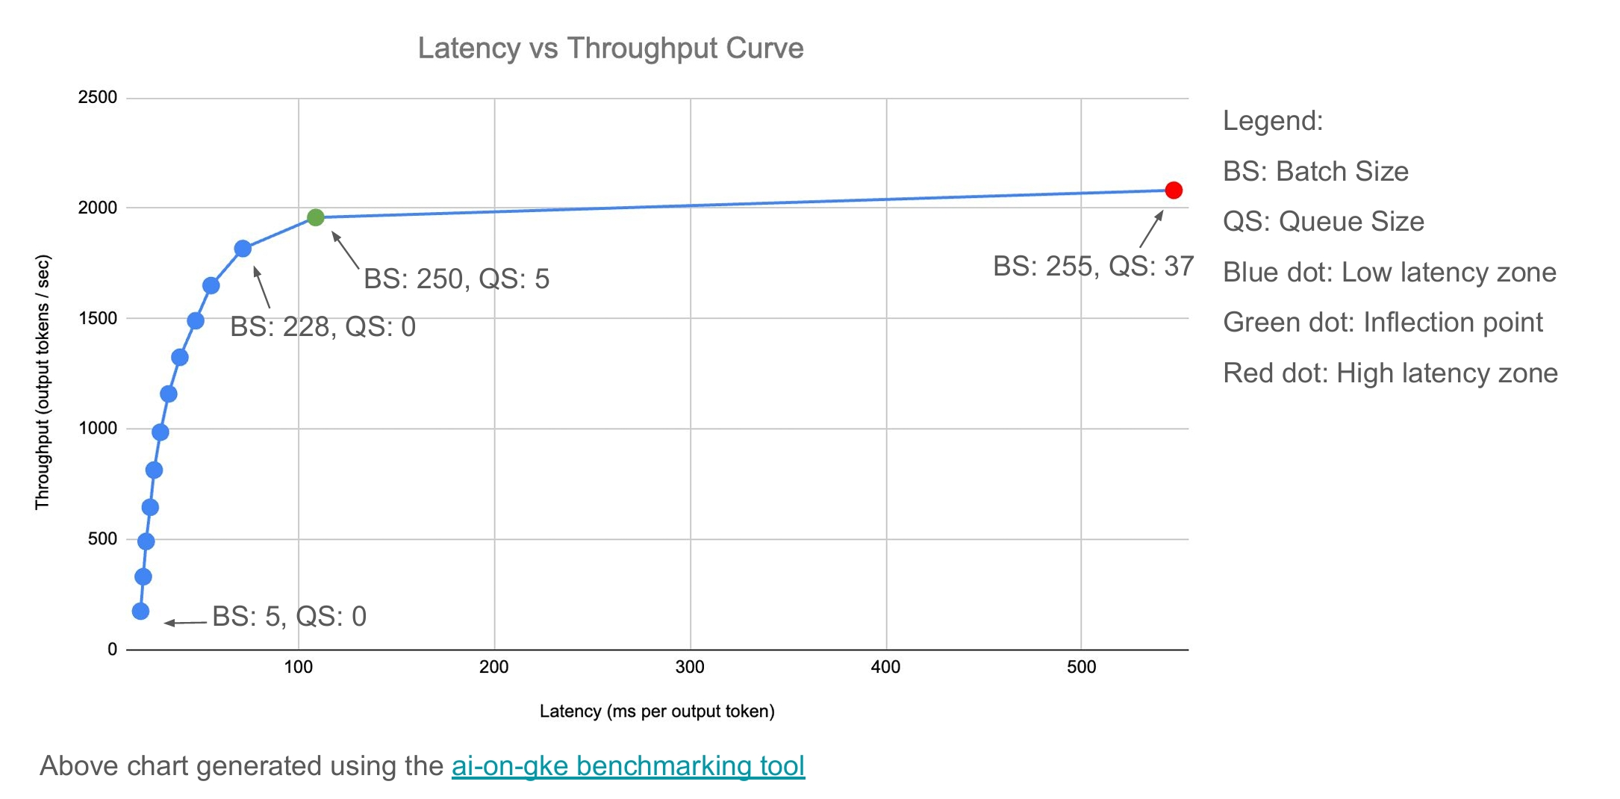
LLM autoscaling: GPU Metrics vs LLM Merics
Lot of GPU utilization metrics available
Duty cycle
Power usage
Memory bandwidth usage
LLM inference bottlenecks make it not so viable for autoscaling
Recommends:
queue size
batch size
KV cache usage percentage

Slide 23
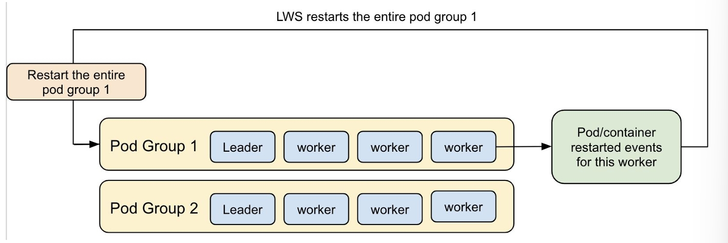
Failure Handling
Any pod/container restarts in a single serving replica will require the entire replica to be restarted. (group restart) This is because the distributed inference workloads need to be re-initiated when any program on different pod in the same group is restarted.

Slide 24
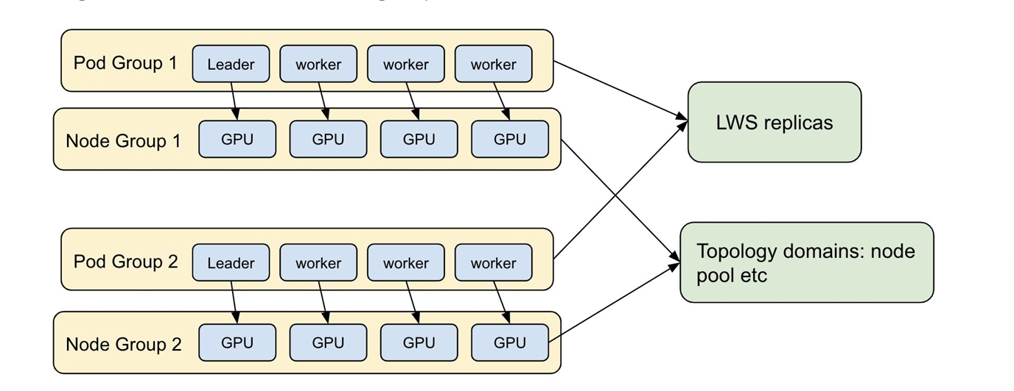
Topology aware scheduling
One pod group/replica will be exclusively scheduled to one topology domain.
One pod group is a single multi-host serving instance
A topology domain here is a group of nodes that share the same node label which categorize them to be the same group
apiVersion: leaderworkerset.x-k8s.io/v1
kind: LeaderWorkerSet
metadata:
annotations:
leaderworkerset.sigs.k8s.io/exclusive-topology: google.com/node-pool
name: multi-node-inference
spec:
...

Slide 25
Rolling update
spec:
rolloutStrategy:
type: RollingUpdate
rollingUpdateConfiguration:
maxUnavailable: 2
maxSurge: 2
replicas: 4
Rolling update is vital to online services with zero downtime. For LLM inference services, this is particularly important, which helps to mitigate stockout. Two different configurations are supported in LWS, maxUnavailable and maxSurge:
artition | Replicas | R-0 | R-1 | R-2 | R-3 | R-4 | R-5 | Note
Stage1 | 0 | 4 | ✅ | ✅ | ✅ | ✅ |  |  | Before rolling update
Stage2 | 4 | 6 | ❎ | ❎ | ❎ | ❎ | ⏳ | ⏳ | Rolling update started
Stage3 | 2 | 6 | ❎ | ❎ | ⏳ | ⏳ | ⏳ | ⏳ | Partition changes from 4 to 2
Stage4 | 2 | 6 | ❎ | ❎ | ⏳ | ⏳ | ✅ | ⏳ | Since the last Replica is not ready, Partition will not change
Stage5 | 0 | 6 | ⏳ | ⏳ | ⏳ | ⏳ | ✅ | ✅ | Partition changes from 2 to 0
Stage6 | 0 | 6 | ⏳ | ⏳ | ⏳ | ✅ | ✅ | ✅
Stage7 | 0 | 5 | ⏳ | ✅ | ⏳ | ✅ | ✅ |  | Reclaim a Replica for the accommodation of unready ones
Stage8 | 0 | 4 | ✅ | ⏳ | ✅ | ✅ |  |  | Release another Replica
Stage9 | 0 | 4 | ✅ | ✅ | ✅ | ✅ |  |  | Rolling update completed
✅ Replica has been updated
❎ Replica hasn’t been updated
⏳ Replica is in rolling update

Slide 26
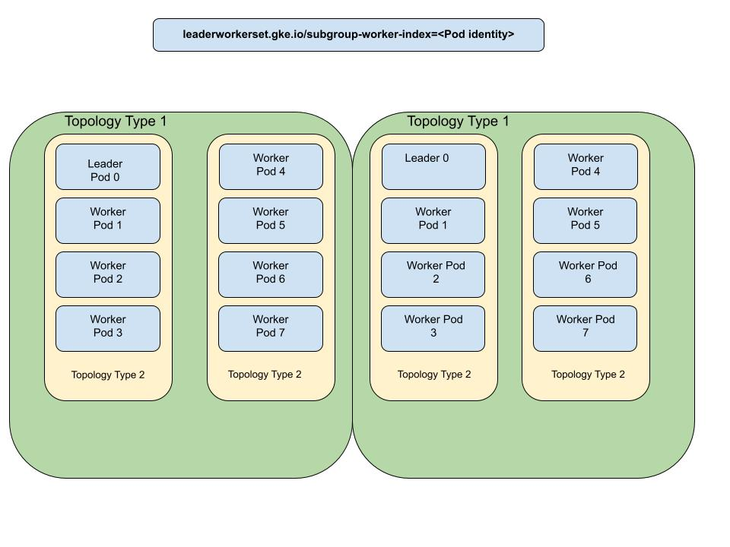
SubGroup
split each LeaderWorkerSet replica into smaller subgroups, and be able to deploy each subgroup on a separate accelerator island.

Slide 27
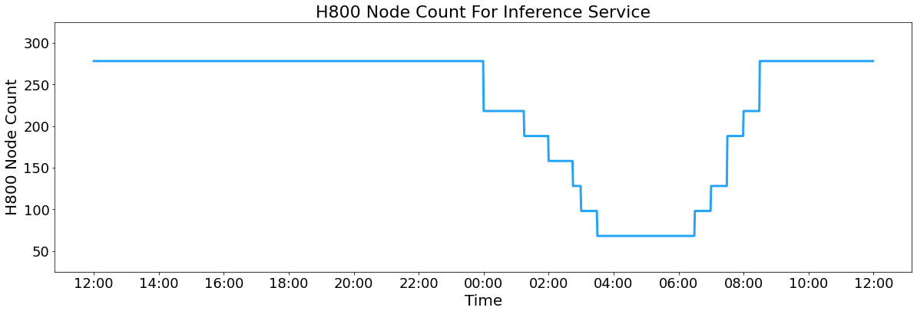
Kueue + LWS
apiVersion: leaderworkerset.x-k8s.io/v1
kind: LeaderWorkerSet
metadata:
name: llm-leaderworkerset
labels:
app: nginx
kueue.x-k8s.io/queue-name: user-queue
推训混布
推理每天 按 Group 伸缩
节约的机器，自动启动训练任务
DeepSeek Inference 每日节点用量图(22 nodes per group)

Slide 28
RoadMap
DRA Support
Gang scheduling
Disaggregating Prefill and Decoding
two LWS instances(recommend) vs subgroup
Volcano integration

Slide 29
技术演进和未来展望
Part
04

Slide 30
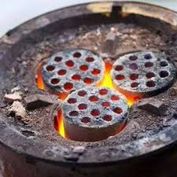
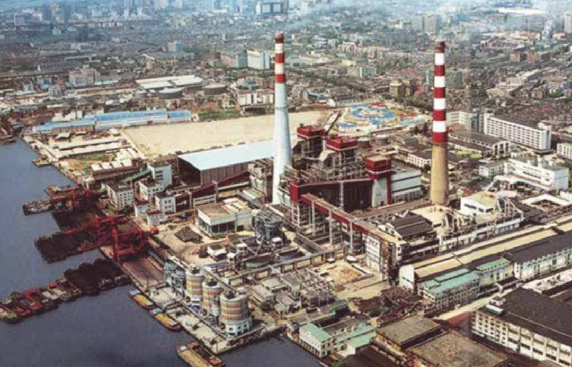
推理的两种主要场景
路径 | 一体机 | 大规模推理集群
核心目标 | 成本够低(100~500/gpu) | 最高 Token per GPU(~10k/gpu)
物质条件 | 1 或 几台 GPU 服务器 | > 50 大卡 GPU
对应技术 | CPU Offload 技术，量化，蒸馏 | 并行优化技术（TP，DP，EP，PP）
类比 | 煤球炉 - 注重实用 | 发电站 - 注重燃烧效率

Slide 31
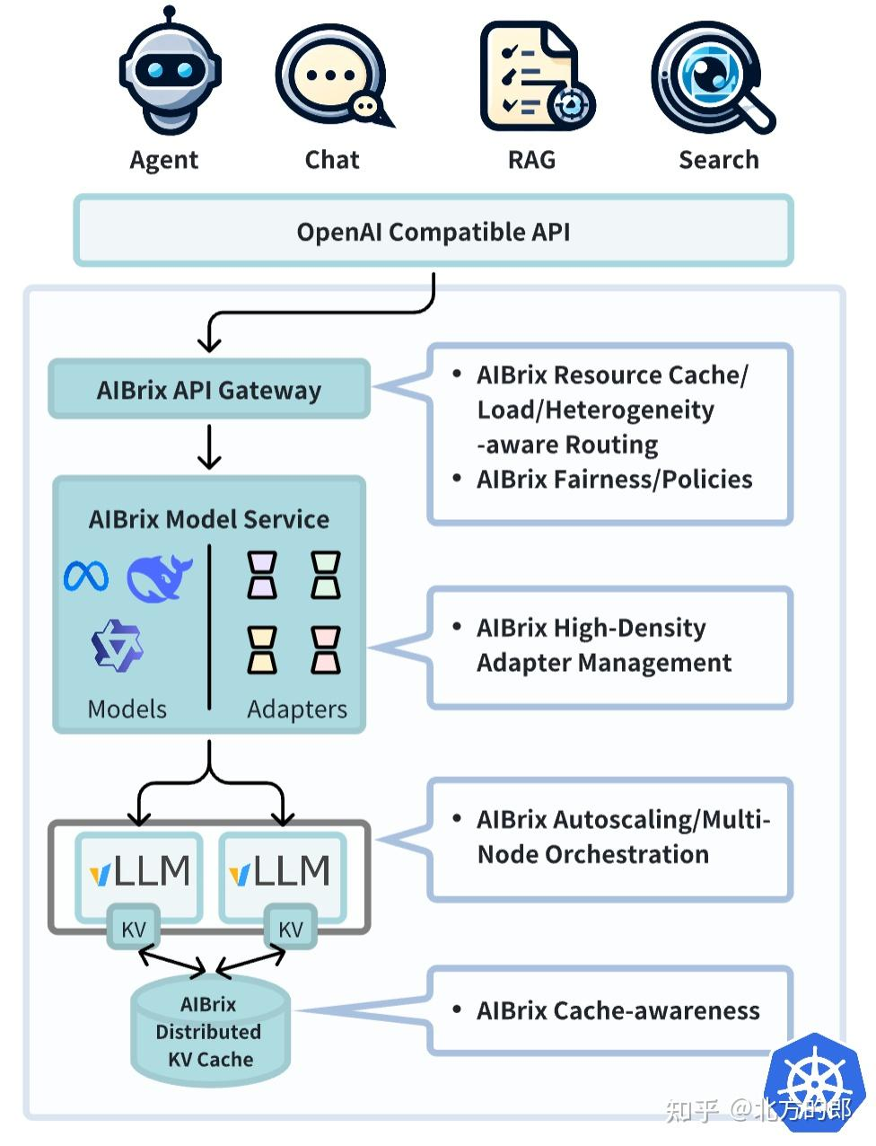
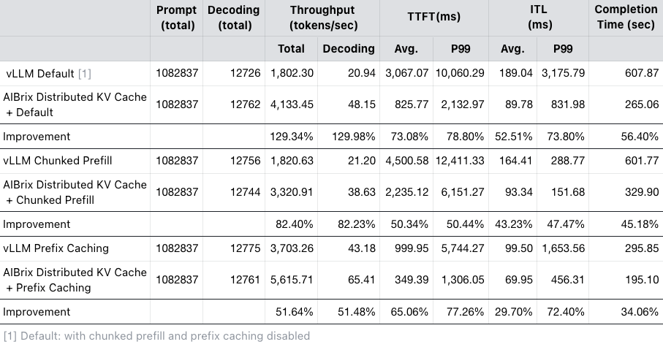
AIBrix
A cloud-native, open-source infrastructure toolkit designed to simplify and optimize LLM deployment.

Slide 32
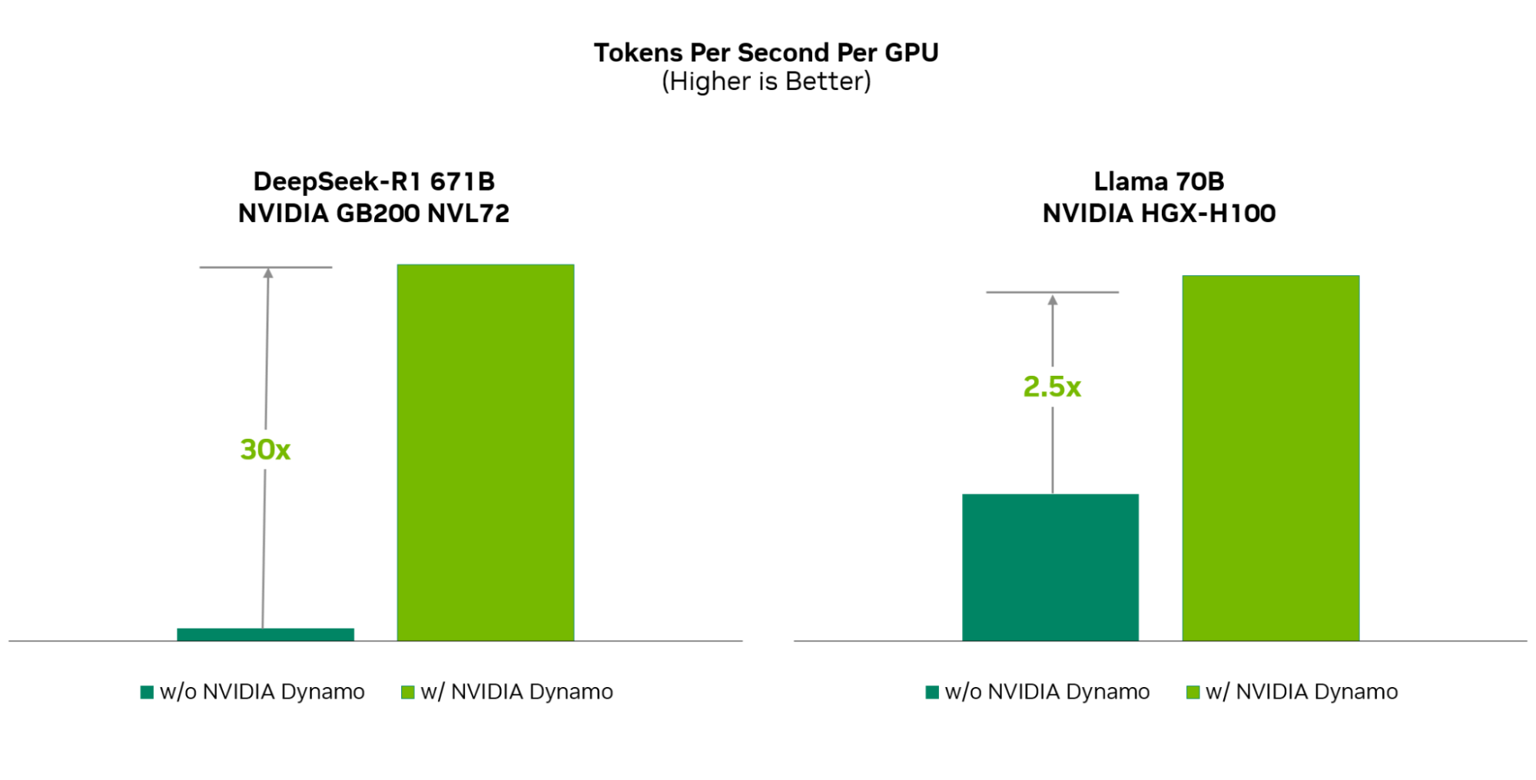
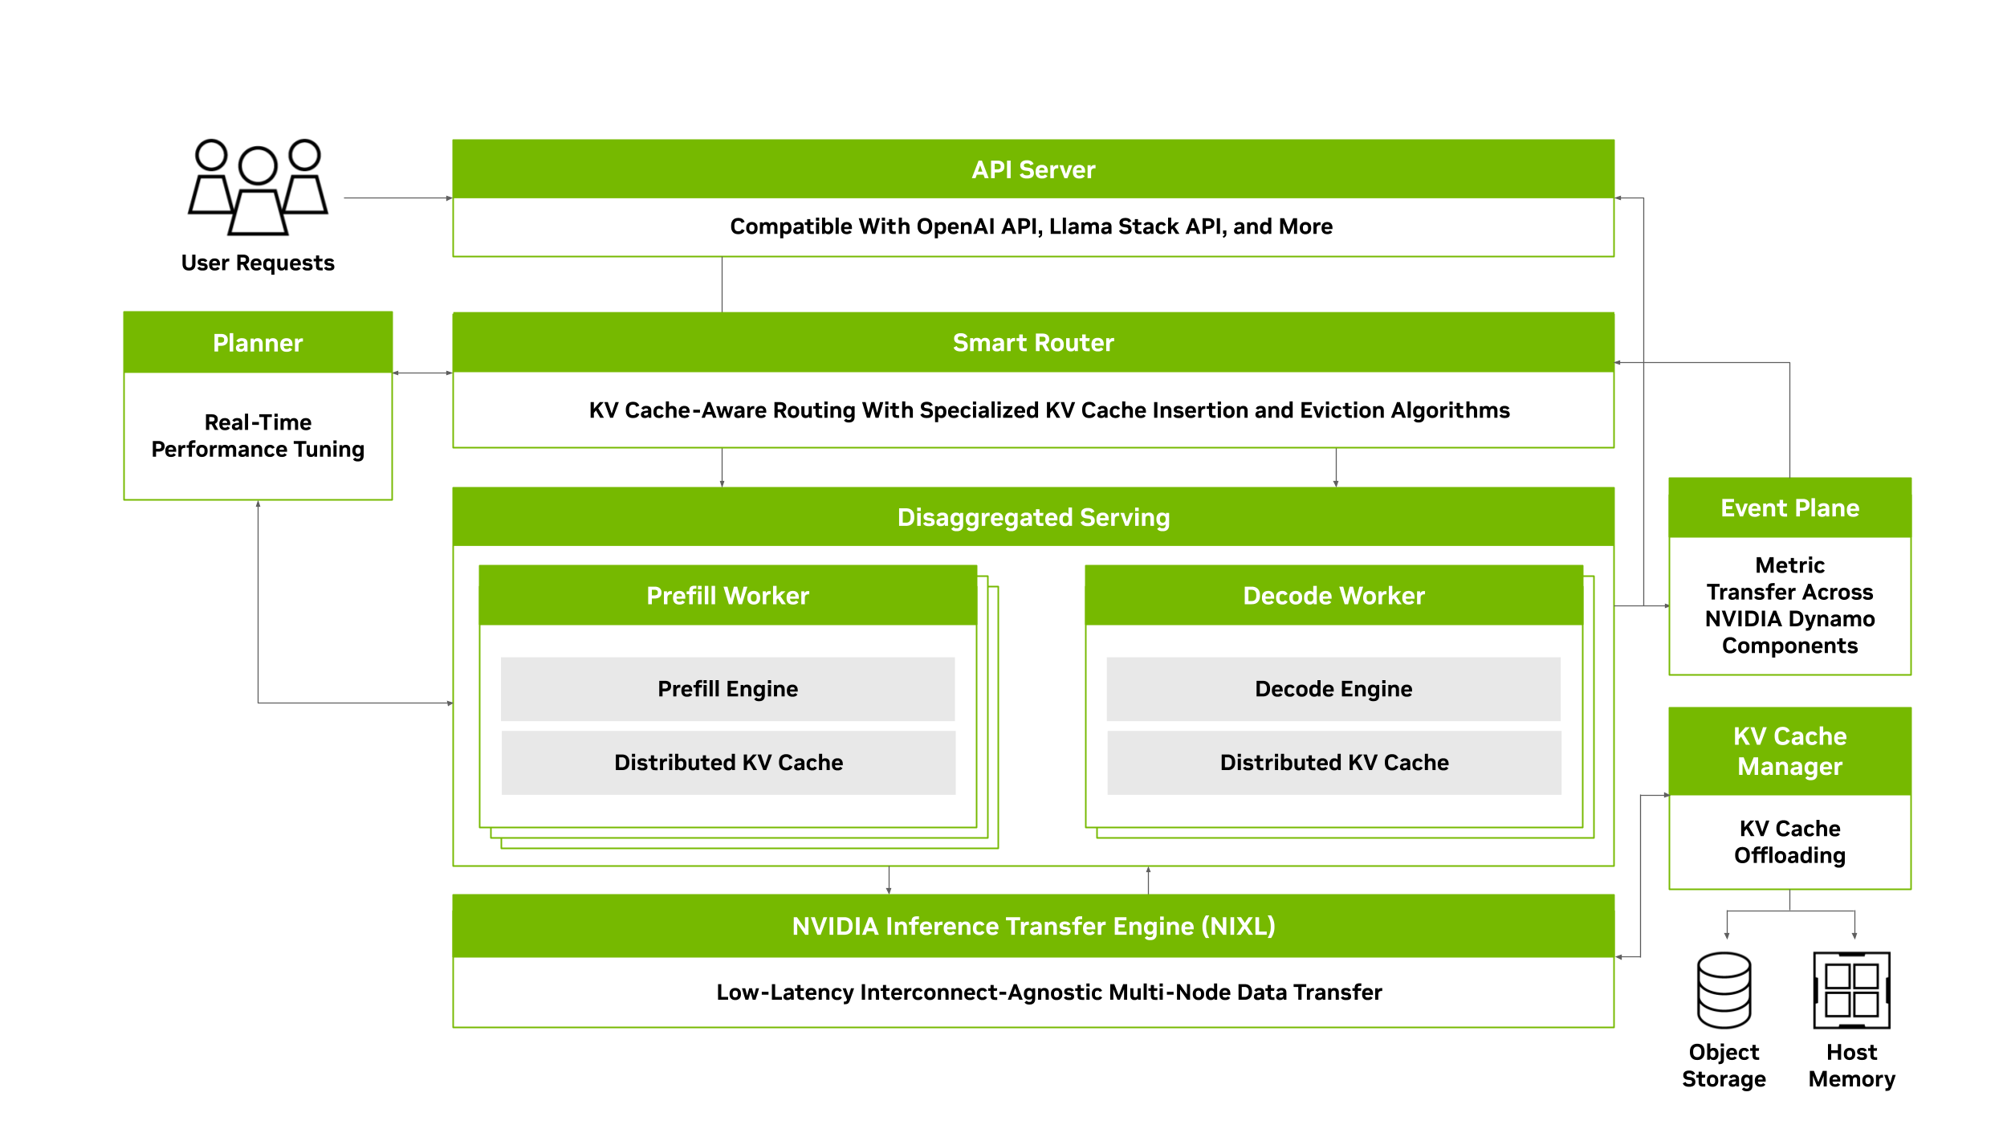
nvidia dynamo
NVIDIA Dynamo is a high-throughput, low-latency open-source inference serving framework for deploying generative AI and reasoning models in large-scale distributed environments.
TensorRT-LLM, FP4, ISL/OSL: 32K/8K.
Without Dynamo: Inflight Batching, TEP16PP4DP4.
With Dynamo: Disaggregated Serving, Context: EP4DP16, Generation: EP64DP3. Projected performance subject to change.

Slide 33
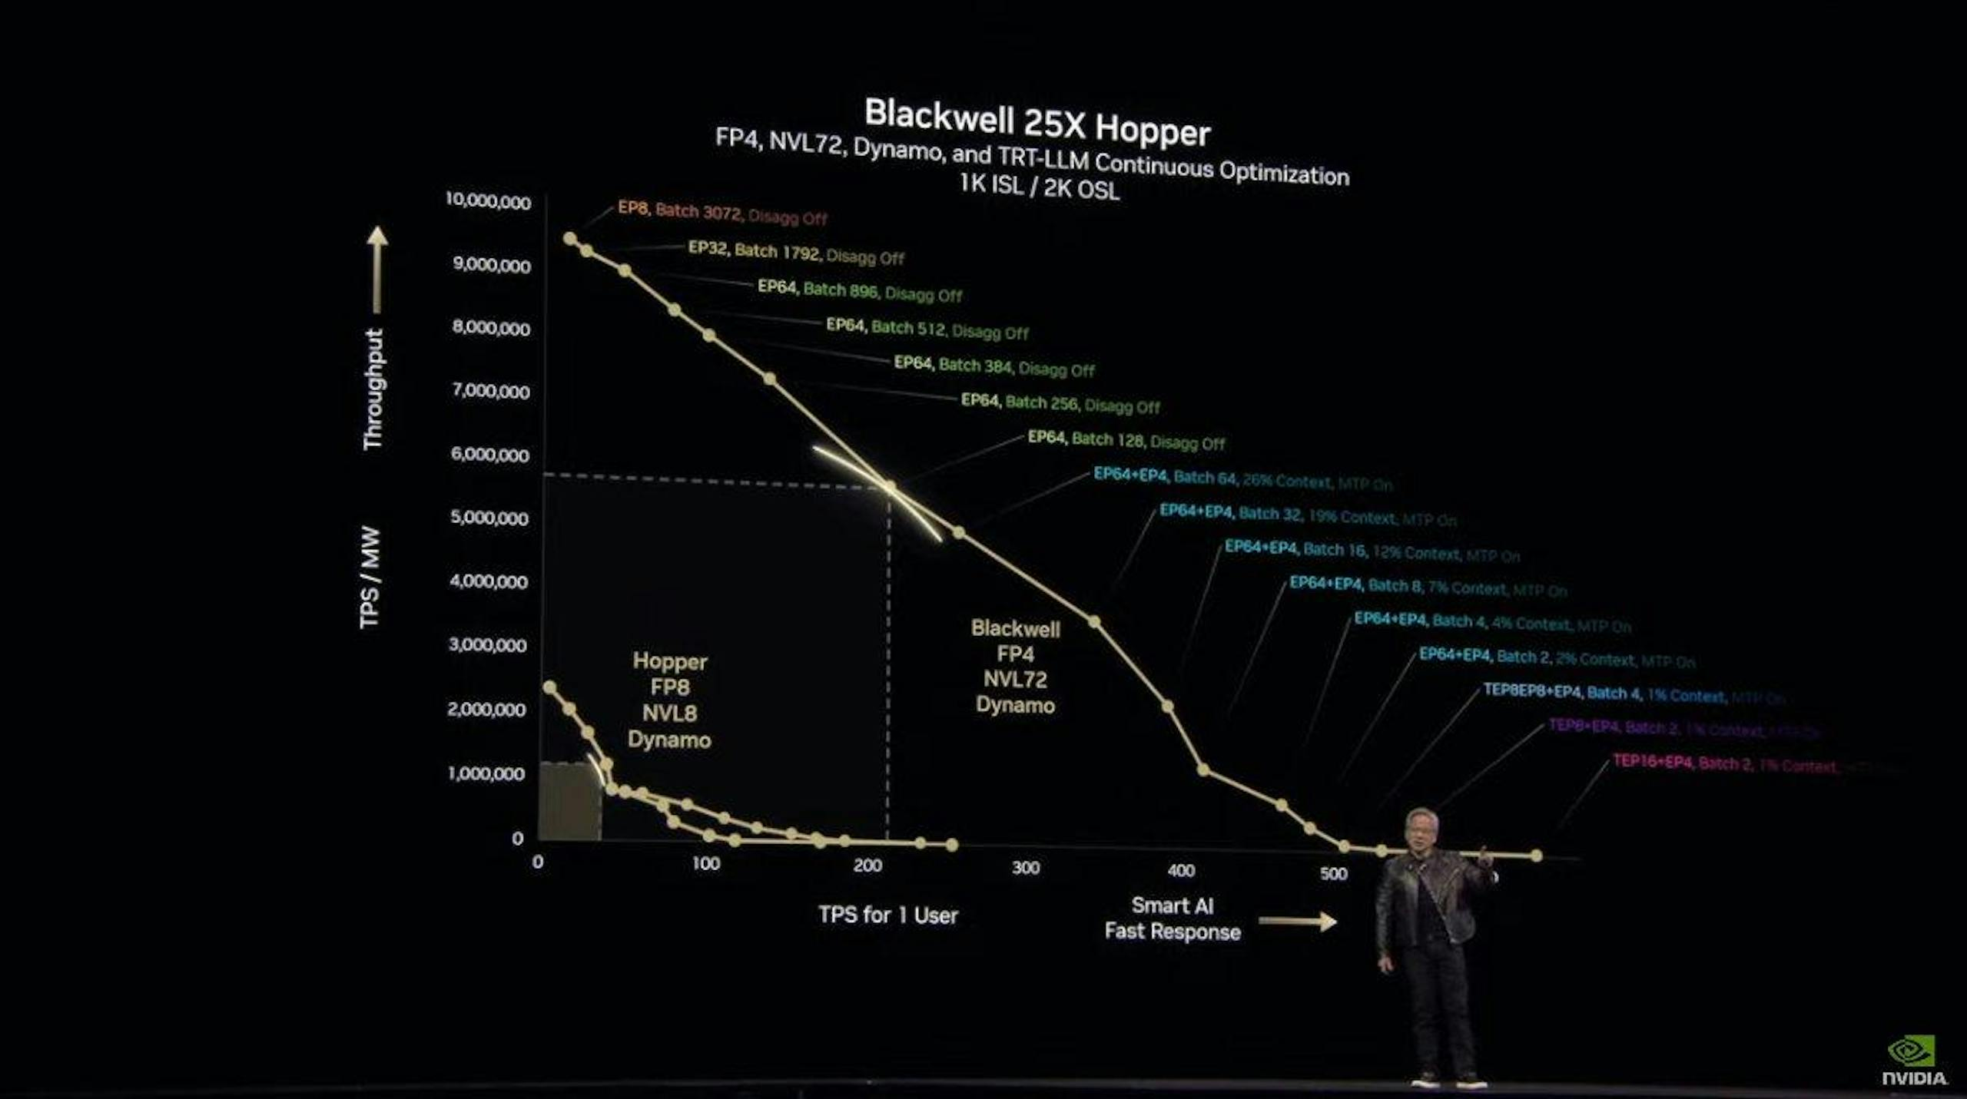
GPU FP4
如果都是 FP8，B200 相对于 H200 提升在 2.3 倍左右。
如果 B200用 新支持的 FP4，而 H200 用 FP8对比，提升 3 倍左右。

Slide 34
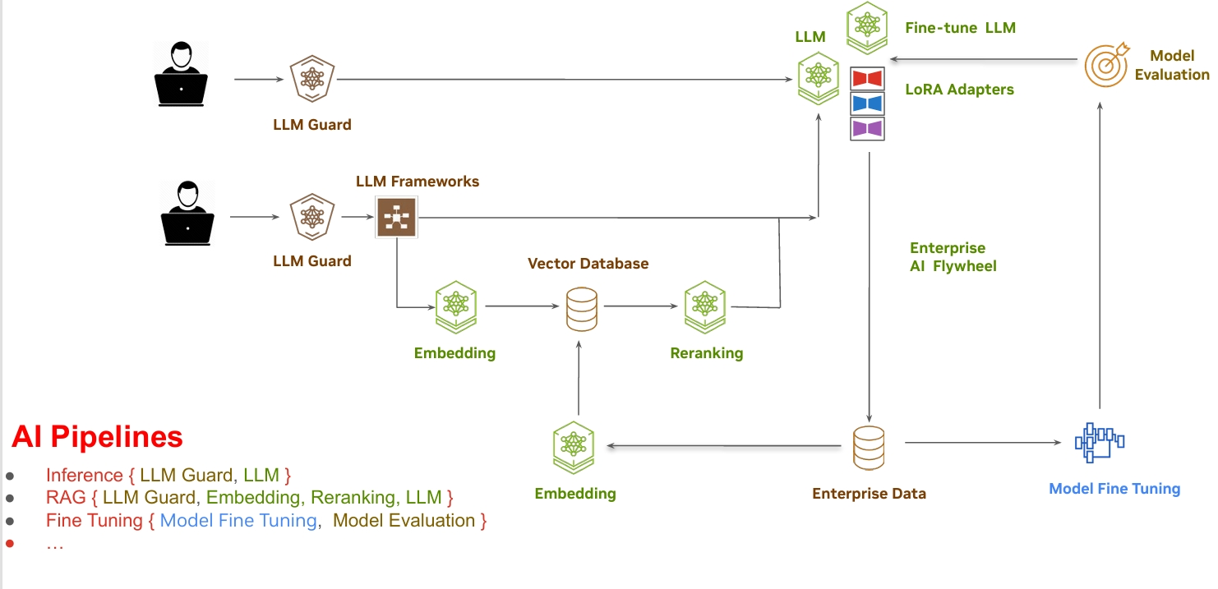
AI Pipelines for Inference

Slide 35
Performance of LLM Inference（Software）: Three-Layer Approach
Open-Source Models: The foundation of AI applications, where model optimizations such as model architecture, Grouped Query Attention (GQA), distillation and adapter finetuning techniques improvements enhance performance and adaptability. e.g. DeepSeek, Qwen, Llama
Inference Engines: These provide efficient execution, KV cache management, model parallelism, attention optimization, and other optimizations that improve model serving performance. e.g. vLLM, Sglang
System-Level Orchestration : The often-overlooked layer that determines real-world cost efficiency and scalability by handling resource scheduling, autoscaling, cache-aware routing, heterogeneity management, and multi-cluster or region resource optimization. e.g. nvidia dynamo, vllm production stack, vllm aibrix, llmaz
https://aibrix.github.io/posts/2025-02-20-vllm-control-plane/#three-layer-approach-open-source-model-vllm-and-aibrix

Slide 36
Thanks.

